Slide 1
LECTURE 1

Slide 2

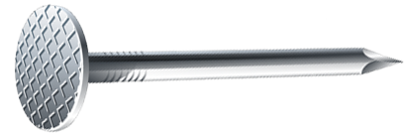


MAGNETIC EFFECTS OF
ELECTRIC CURRENT

Slide 3
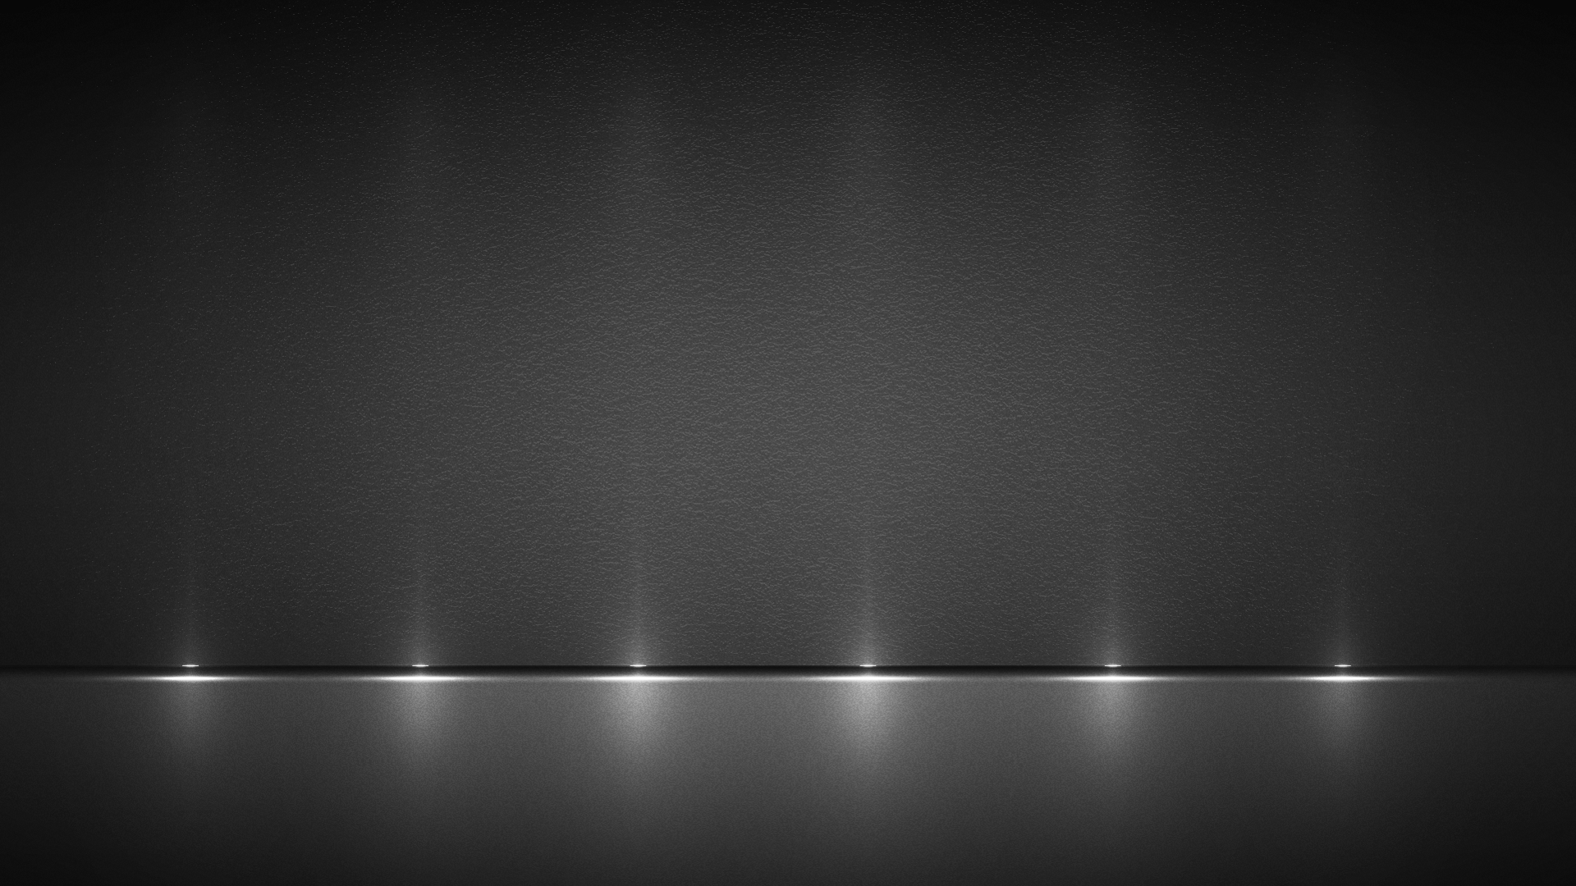
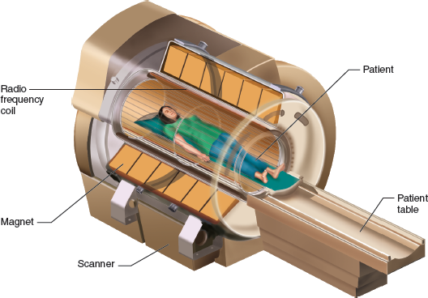



Maglev Train
Speaker
MRI Machine
N
S
N
S
N
N
S
N
S
N

Slide 4



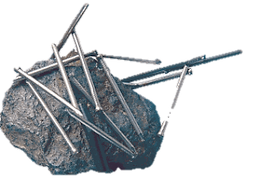
Asia Minor
A small state in
Greece
Ancient Chinese found this stone
MAGNESIA
When suspended, always points in north - south direction
It was used for navigation.

Slide 5


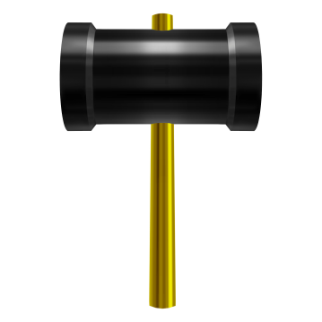
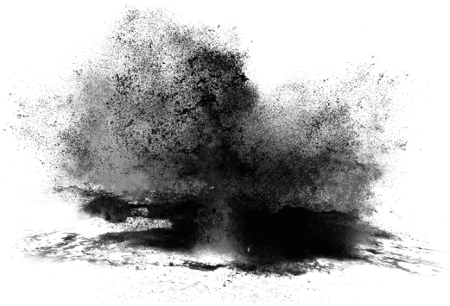
S
N
S
A magnet is always dipole
N
N
S
N
S
S
N
S
N
S
N
S
S
N
N
S
N
N
S
N
S
BAR MAGNET
One cut end becomes a North pole
One cut end becomes a South pole
N
N
N
N
N
N
N
S
N
S
S
S
S
S
S
S

Slide 6
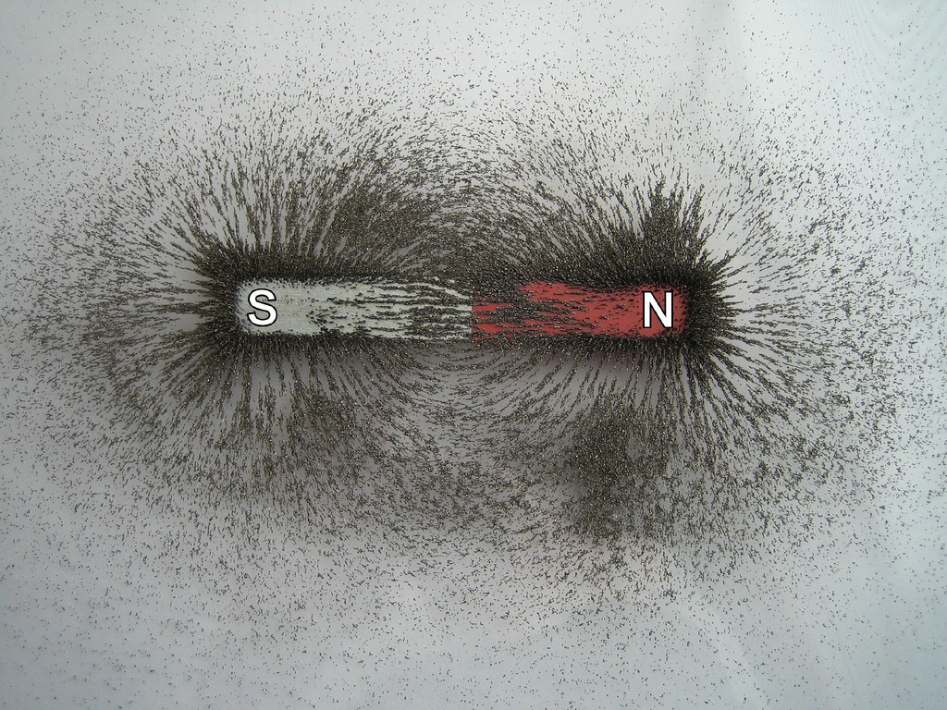
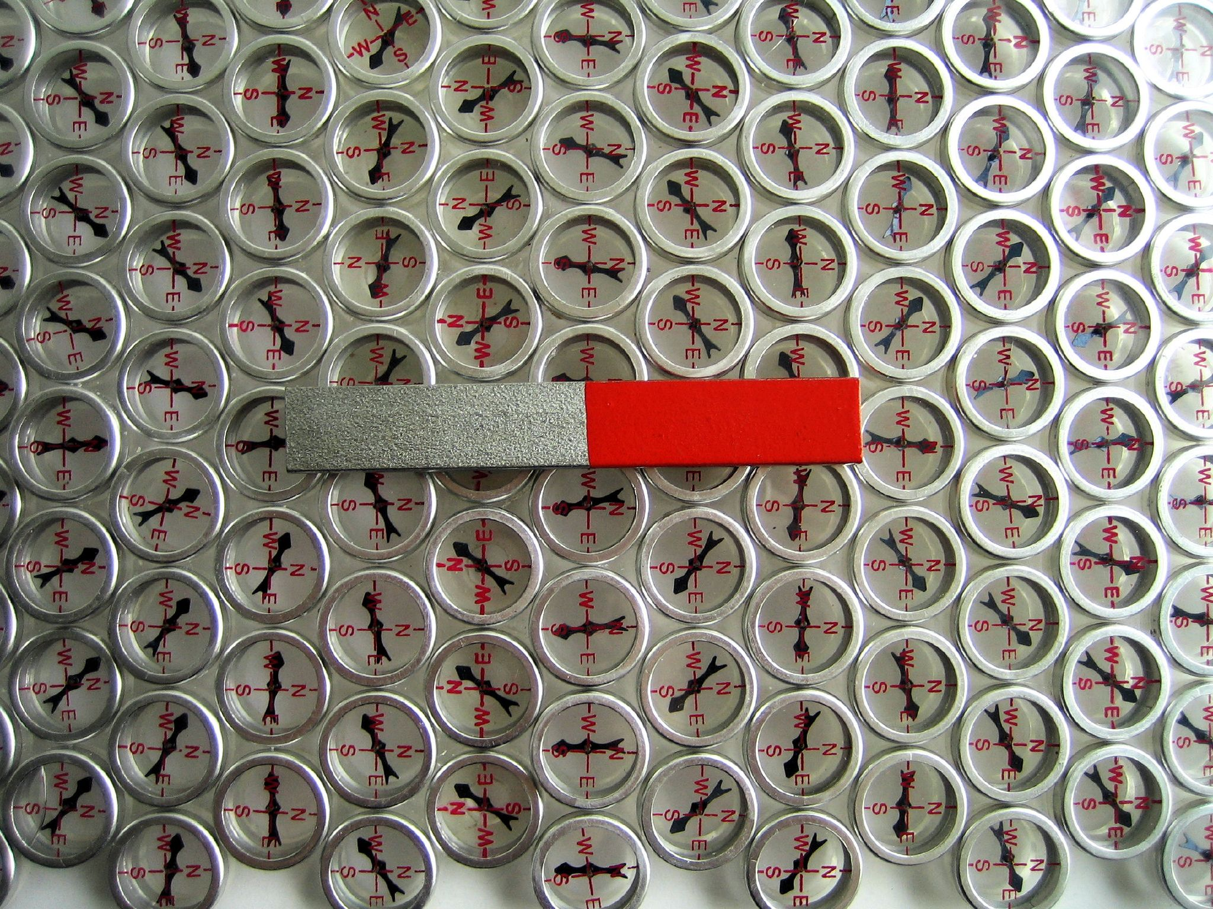


MAGNETIC LINES OF FORCE
N
S
Magnetic field
Magnetic field lines
or
Lines of force
Properties of magnetic field lines
Magnetic field is a quantity that has both direction and magnitude.
Field lines emerge from north pole and merge at the south pole.
The direction of the magnetic field is taken to be the direction in which a north pole of the compass needle moves inside it.
Inside the magnet the direction of field lines is from south pole to north pole so the field lines are closed continuous curves.
The relative Strength of the magnetic field is shown by the degree of closeness of the field lines.
N
S
If they did, it would mean that at the point of intersection. The compass needle would pointed towards two directions which is not possible.
No two field – lines are found to cross each other.

Slide 7
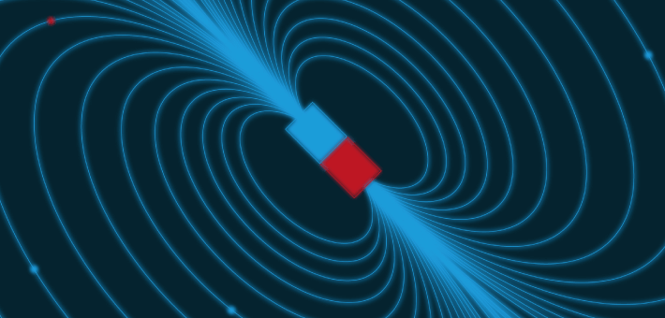
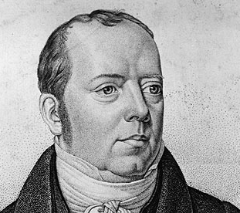
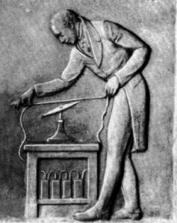

Magnetic Effect Of Electric Current
Discovered Radio, TV, Fibre optics.
HANS CHRISTIAN OERSTED (1820)

Slide 8


Magnetic Effect Of Electric Current
SNOW
+
–
+
–
–
+
A
B
A
B
A
B
This proves magnetic effect of current
When current flows from South to North the North pole of the magnet deflects Over West

Slide 9





MAGNETIC FIELD FOR A STRAIGHT CONDUCTOR
Ammeter
B
+
–
A
Rheostat
–
+
Battery
A
Plug key
How to find direction of magnetic field ?

Slide 10
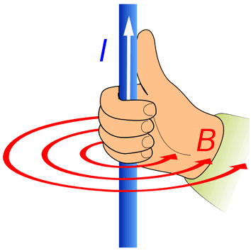
MAGNETIC FIELD FOR A STRAIGHT CONDUCTOR
Magnetic field
RIGHT HAND THUMB RULE
B
+
–
Current
A
Imagine that you have held the conductor in your right hand in such way that your thumb points in the direction of the current.
–
+
Then turn your fingers around the conductor, the direction of the fingers is the direction of the magnetic lines of force.
A

Slide 11

MAGNETIC FIELD FOR A STRAIGHT CONDUCTOR
B
+
–
A
–
–
+
+
magnetic field is
anticlock-wise
magnetic field is clock-wise
A

Slide 12

MAGNETIC FIELD FOR A STRAIGHT CONDUCTOR
Current decreases
B
Magnetic field increases
–
Current increases
Magnetic field ∝ Current
+
Magnetic field decreases
A
–
1
–
–
Magnetic field ∝
Distance
+
+
+
A

Slide 13



Q.
Why does a compass needle get deflected when brought near a bar magnet?
Ans.
The magnetic field of the magnet exerts force on both the poles of the compass needle.
The forces experienced by the two poles are equal and opposite. These two forces form a couple which deflects the compass needle.
N
S

Slide 14
AB is a current carrying conductor in the plane of the paper as shown in figure.
(i) What are the directions of magnetic fields produced by it at points P and Q?
(ii) Given r₁ > r₂, where will the strength of the magnetic field be larger?
Q.
Ans.
A
By applying Right-hand thumb rule, the direction of Magnetic field at P is into the plane of the paper and at the point Q, coming out from the plane of paper.
r₁
P
I
Q
r₂
The magnitude of magnetic field B is inversely proportional to distance r. Since r1 > r2, point Q is closer than point P. So the magnetic field is stronger at point Q and weaker at point P.
B

Slide 15
Thank You

